Slide 1
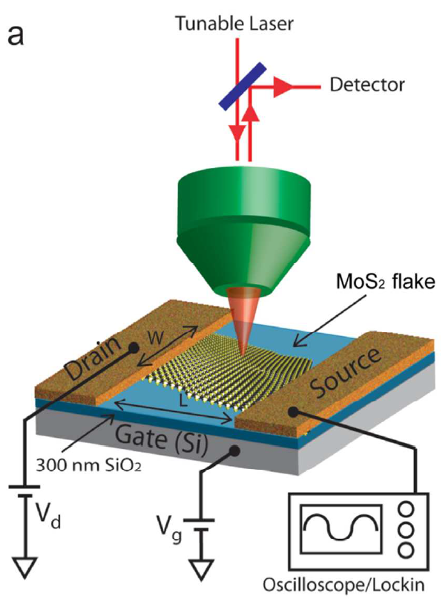
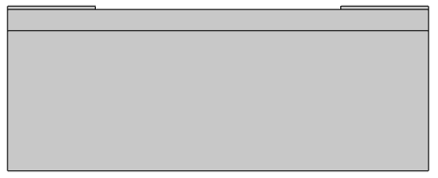
MoS2 FET

Slide 2
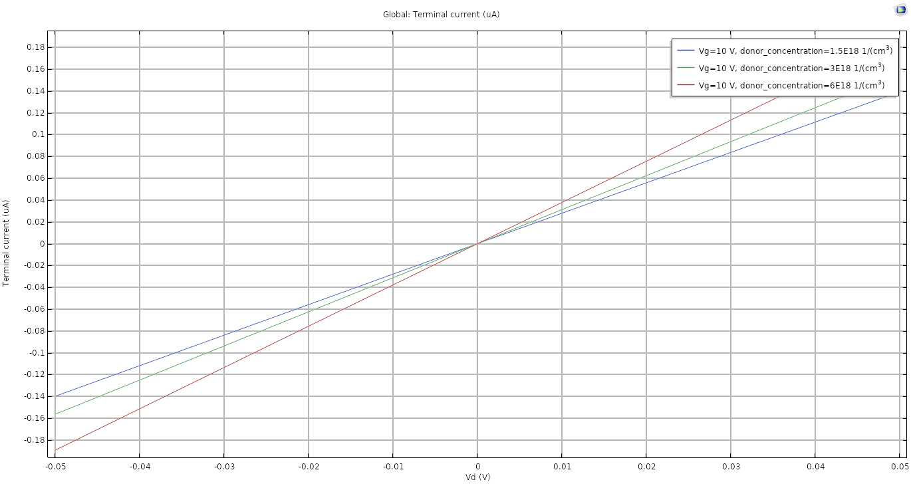
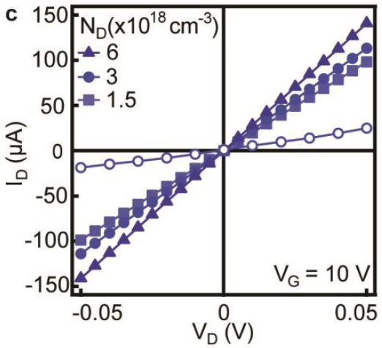
Output characteristics when $V_{g}=10V$ for a 1L thick FET.

Slide 3
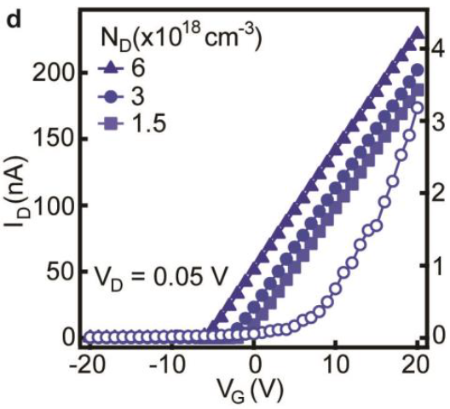
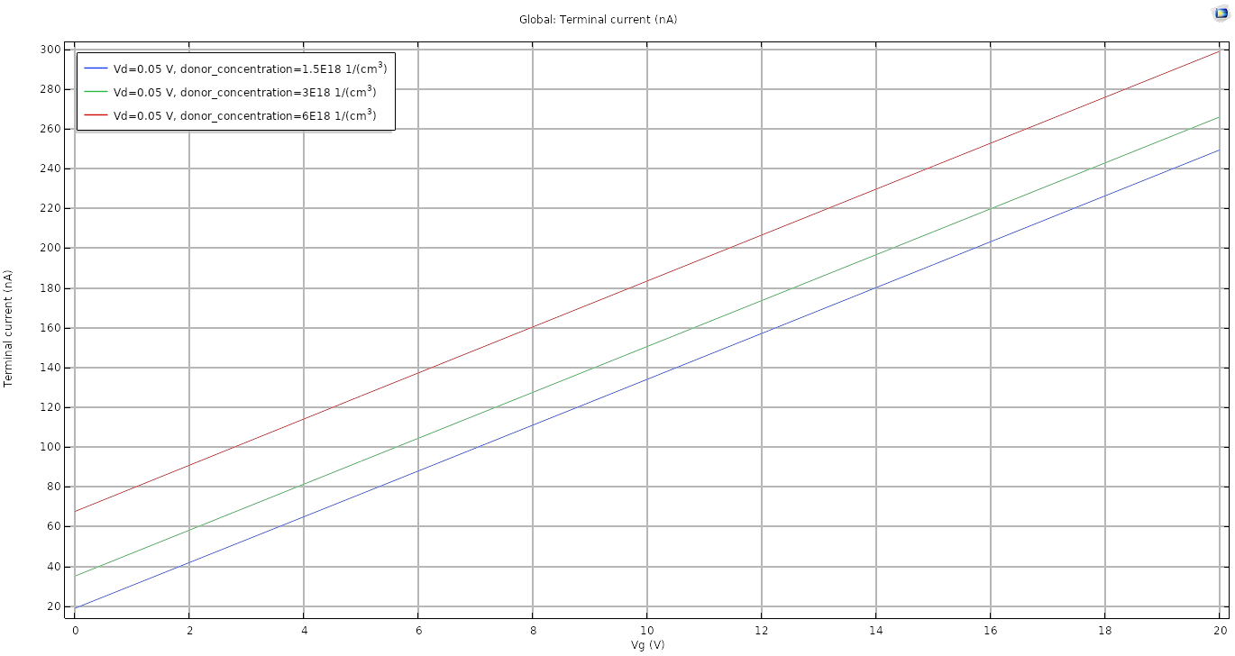
Transfer characteristics when $V_{d}=0.05 V$ for a 1L thick FET.

Slide 4
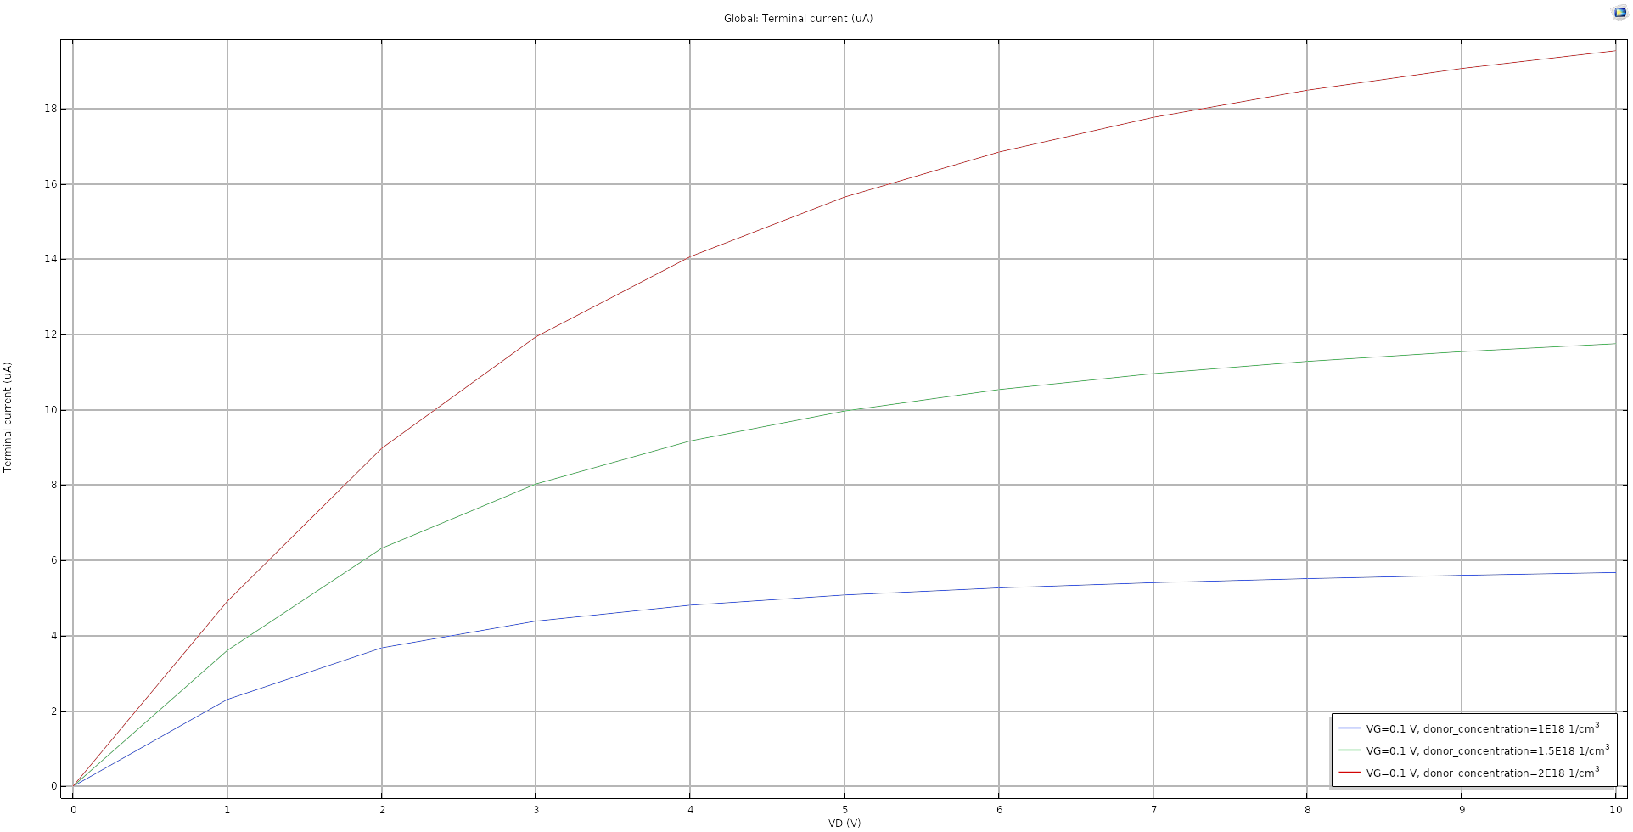
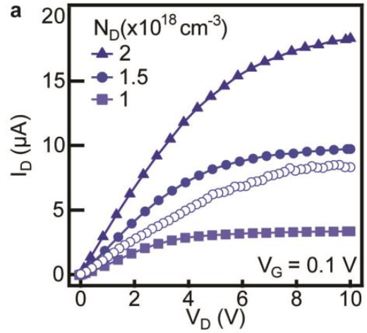
Output characteristics when $V_{g}=0.1 V$ for a 4L thick FET.

Slide 5
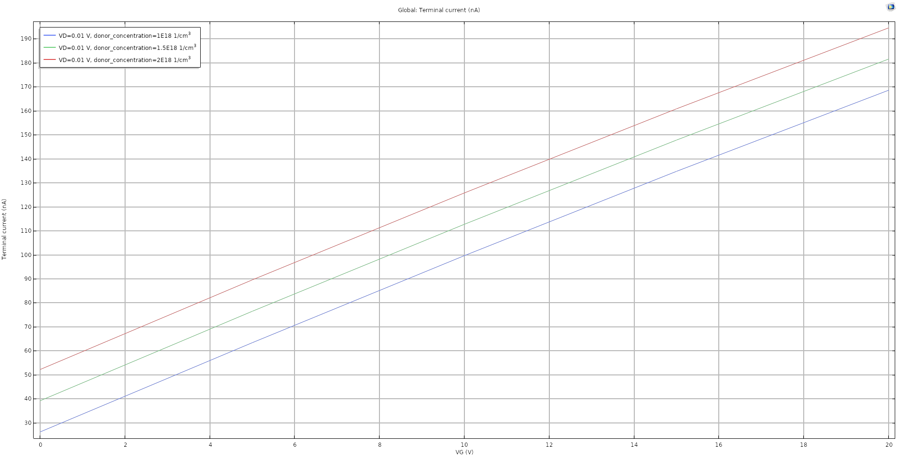
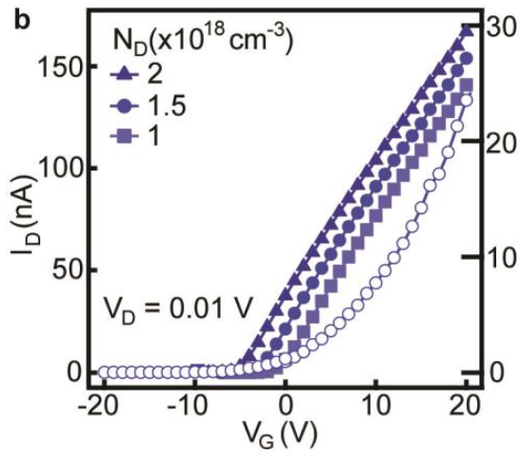
Transfer characteristics when $V_{d}=0.01 V$ for a 4L thick FET

Slide 6
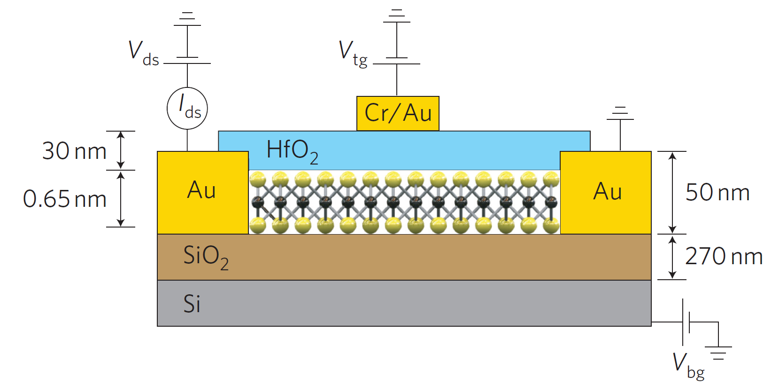
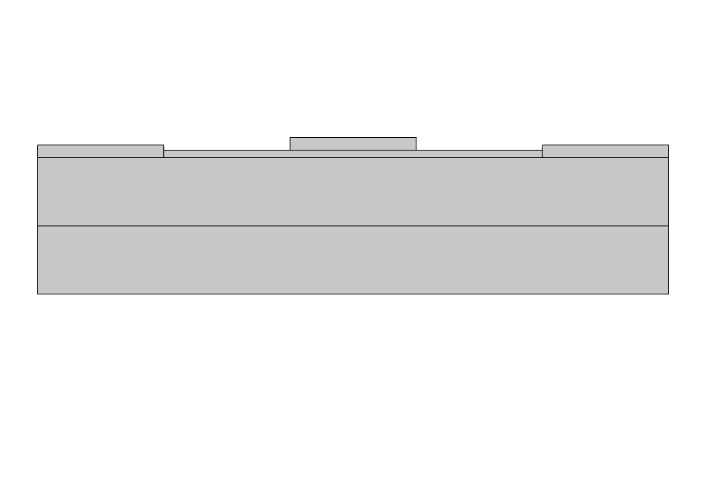
MoS2 con HfO2

Slide 7
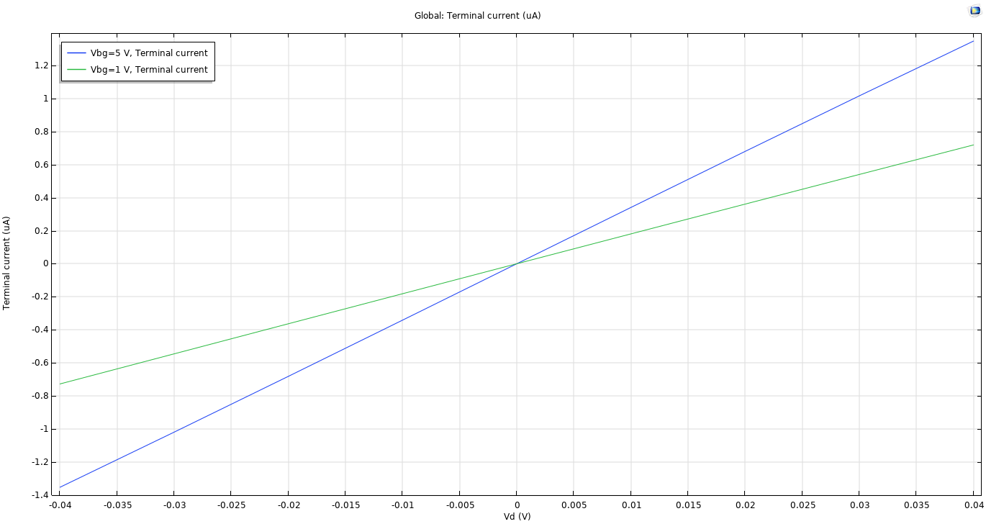
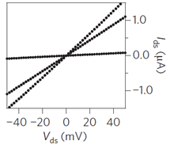
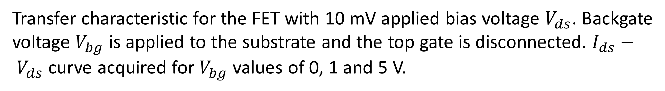
Transfer characteristic for the FET with 10 mV applied bias voltage $V_{ds}$. Backgate voltage $V_{bg}$ is applied to the substrate and the top gate is disconnected. $I_{ds}− V_{ds}$ curve acquired for $V_{bg}$ values of 0, 1 and 5 V.

Slide 8
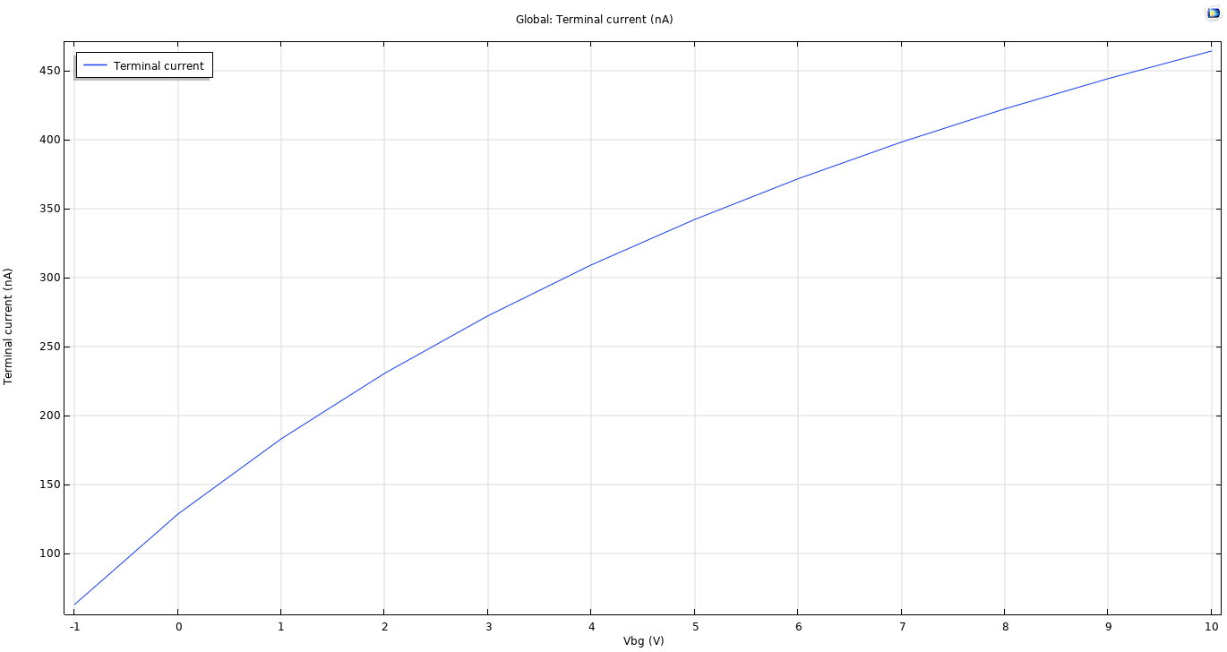
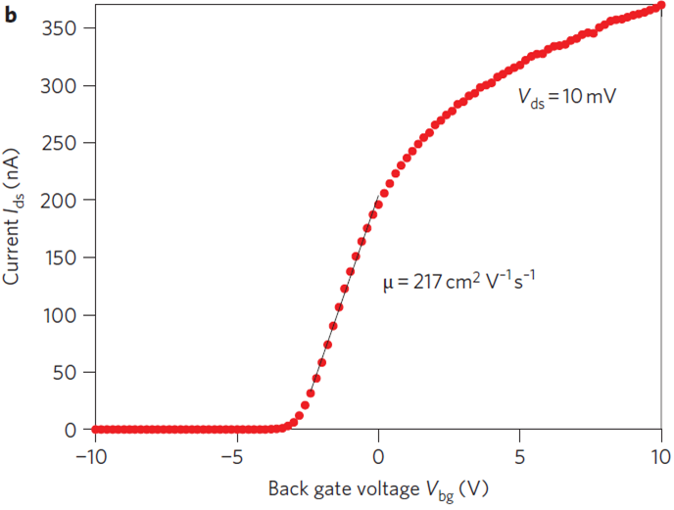
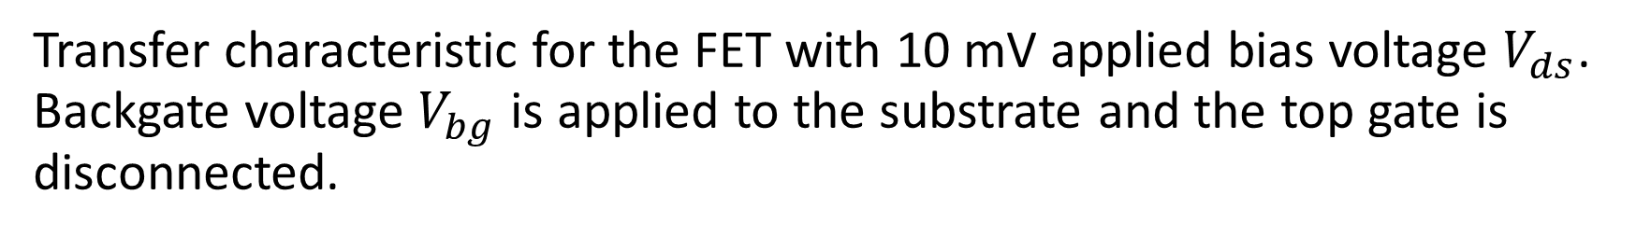
Transfer characteristic for the FET with 10 mV applied bias voltage $V_{ds}$. Backgate voltage $V_{bg}$ is applied to the substrate and the top gate is disconnected.

Slide 9
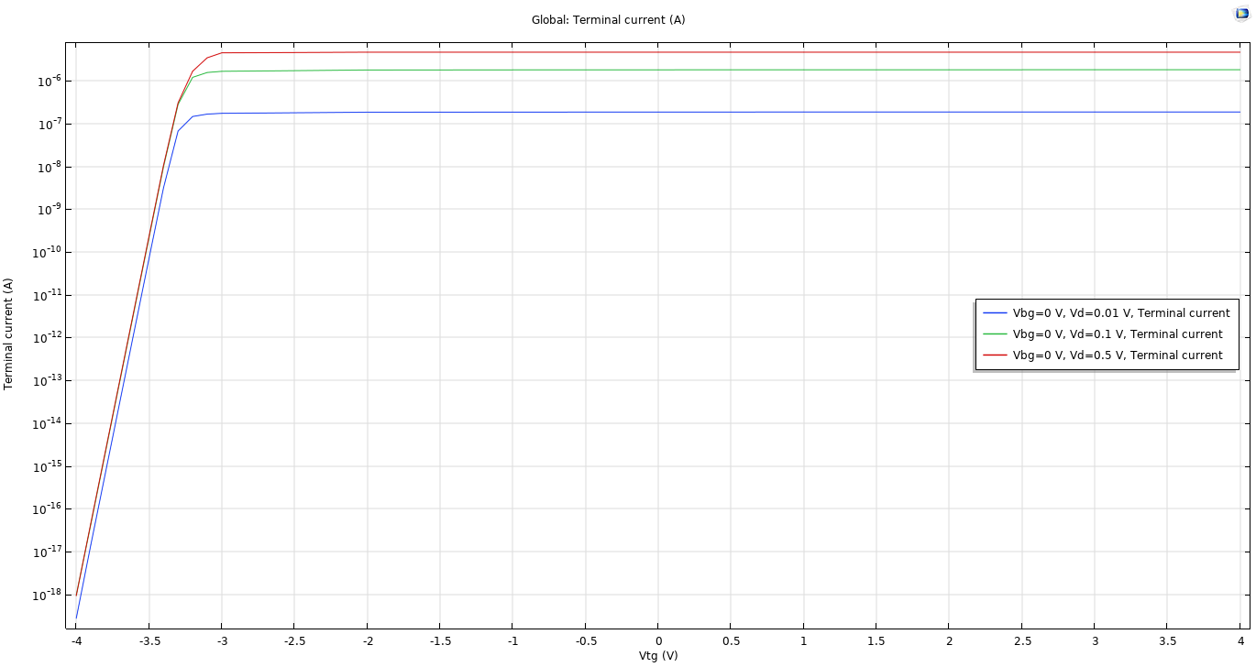
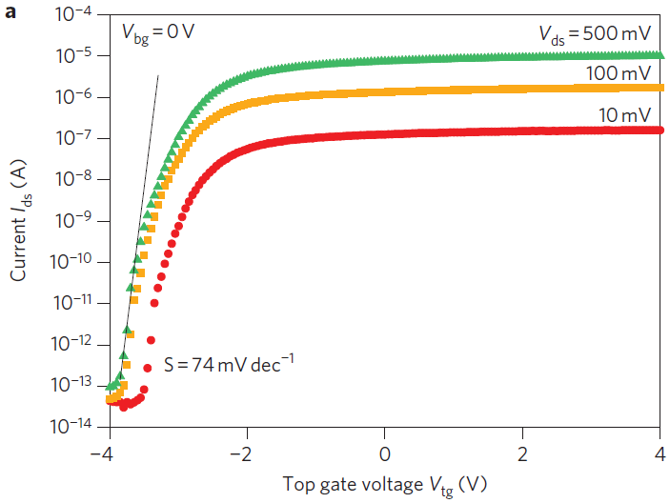
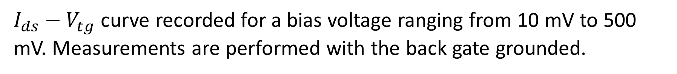
$I_{ds}−V_{tg}$ curve recorded for a bias voltage ranging from 10 mV to 500 mV. Measurements are performed with the back gate grounded.

Slide 10
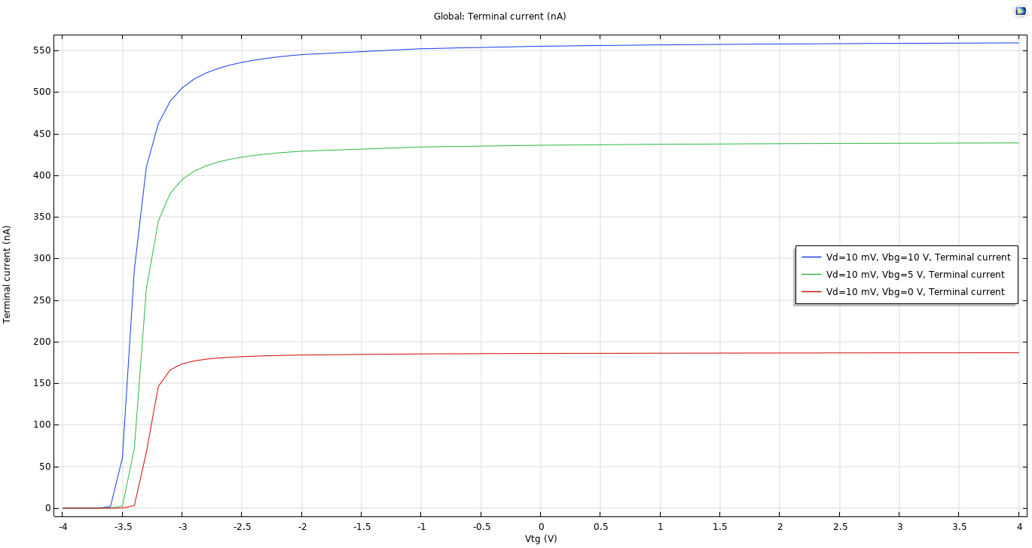
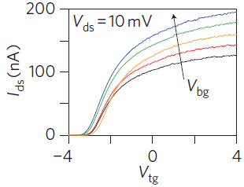
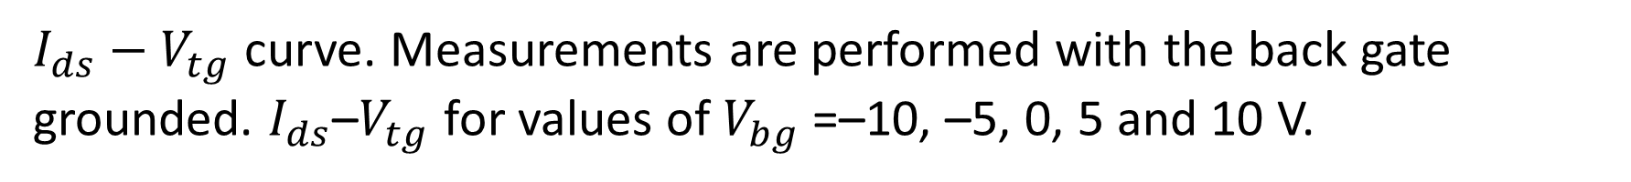
$I_{ds}−V_{tg}$ curve. Measurements are performed with the back gate grounded. $I_{ds}$–$V_{tg}$ for values of $V_{bg}$=–10, –5, 0, 5 and 10 V.

Slide 11
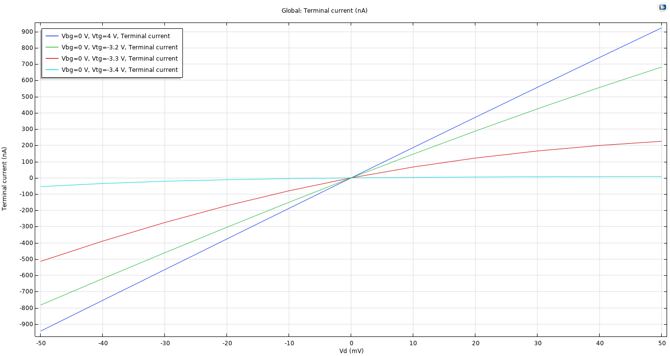
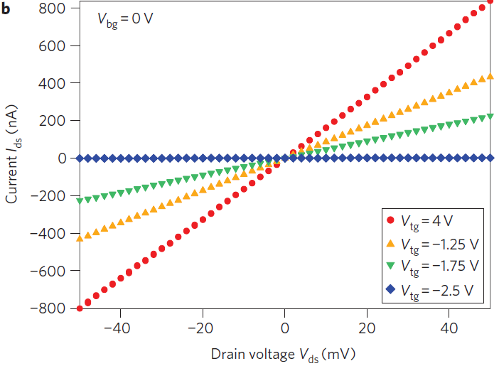
$I_{ds}−V_{ds}$ curves recorded for different values of $V_{tg}$.

